Slide 1
Inflation Forecasting With Commodities
Alvin Wang / Dayou Li / Tianjian Che / Xiaoyang Chi

Slide 2
Intro
Inflation has not been a serious and persistent economic problem in developed country for decades. However, in the wake of the Covid-19 pandemic, fears of inflation have returned. Where is inflation headed, and how can we use what we know to predict where it will go in real time? Today we try to use machine learning models in order to find a more accurate measurement method of nowcasting the inflation rates with pricing of commodities.

Slide 3
Data
Kaggle: Historical commodity (daily) price from 2000-2022 (March) of Gold, Palladium, Nickel, Brent Oil, Natural Gas and Wheat
Kaggle: U.S. CPI

Slide 4
Feature Engineering
Remove NaNs and fill in with next valid value
Mixed frequency dataframe:
X in days, Y in months
Take means of X each month
Define year to year growth rate:
Growth=(this year CPI-last year CPI)/last year CPI

Slide 5
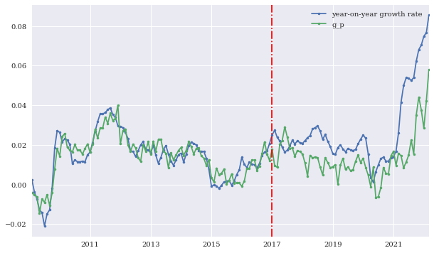
First Attempts: OLS
Select data from 2009-2022
Use Date before 2017 as training set, after as testing set

Slide 6
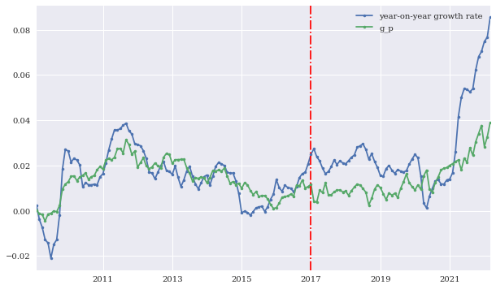
Linear Regression with Lasso Regularization

Slide 7
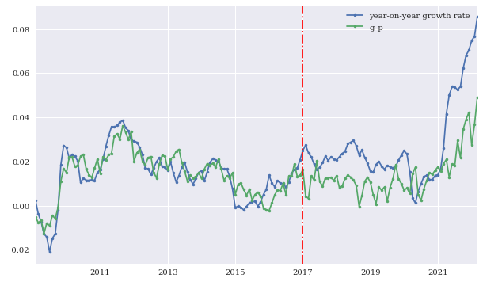
Linear Regression with Ridge Regularization

Slide 8
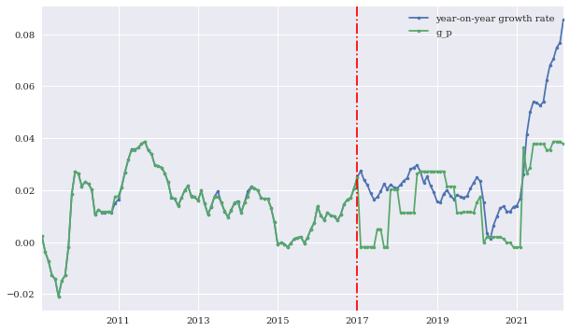
Decision Tree

Slide 9
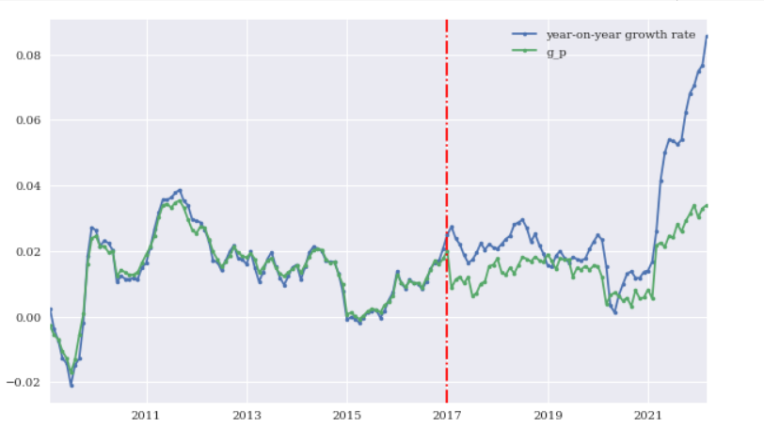
Random Forest

Slide 10
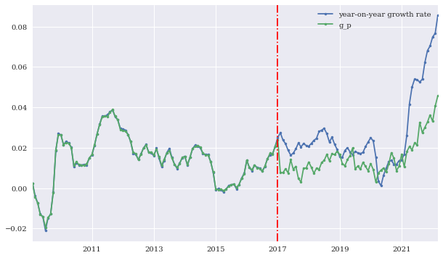
XGBoost

Slide 11
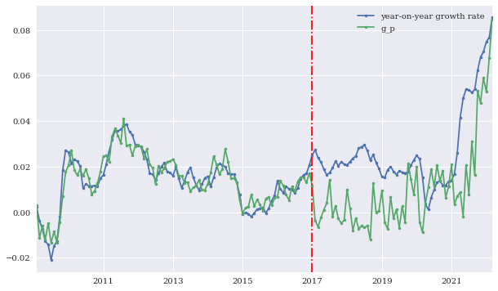
Multilayer Perceptron
10 layers

Slide 12
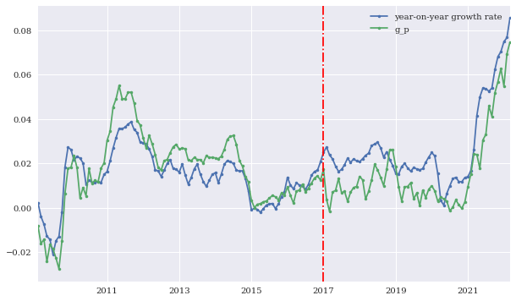
LSTM

Slide 13
Model MSEs
 | Training MSE | Testing MSE
OLS | 2.9104948516751224e-05 | 0.0003298666400212202
LassoCV | 5.0932319589503475e-05 | 0.00035088866067721177
RidgeCV | 3.68902460248577e-05 | 0.00033034868436919413
Decision Tree | 1.8067843114297657e-07 | 0.00028472309805151636
Random Forest | 3.929795329486218e-06 | 0.00029031614677209805
XGB | 2.0120924594331378e-07 | 0.0002871991363157281
MLP | 2.383843843916805e-05 | 0.0004979056514379927
LSTM | 6.995119679684246e-05 | 0.00017586422637605402

